Slide 1
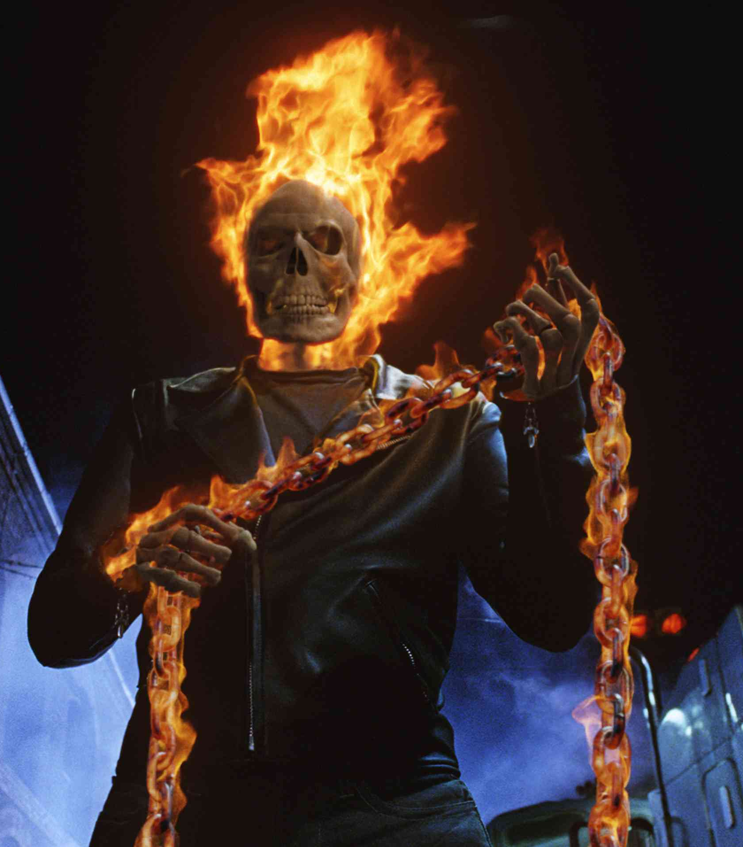
Linked Lists
Nicholas Cage
Prof. Darrell Long
CSE 13S
Links

